Slide 1
Project Discussion
27th March 2018

Slide 2
Problem Statement
Women Health care requirements seem to increase at a rapid pace of 6% y-o-y and understanding these patterns could greatly influence and help in delivering expert advise and quality care
A US non profit organization has provided survey related information for 3 consecutive years of various women along with 14 possible health care requirements that they needed in the last one year

Slide 3
Problem Statement
People across the United States were asked a series of over 1700 questions about their demographics, pregnancies, family planning, use of healthcare services, and medical insurance. We're focusing on the respondents to these questions that are women, and each row in the provided data represents an individual.

Slide 4
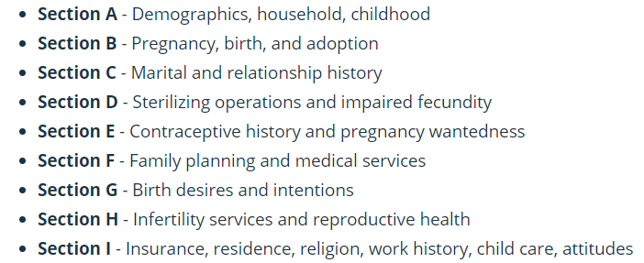
Problem Statement – Data Description

Slide 5
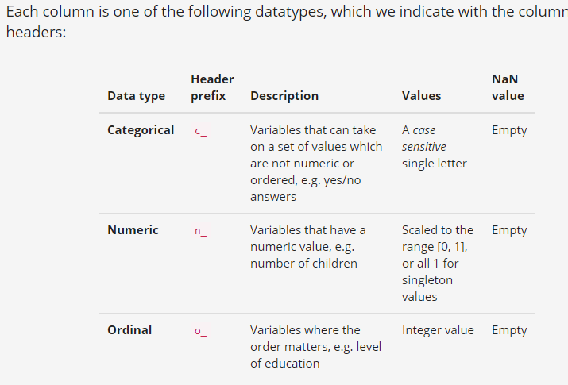
Data Description
You may observe that the data is extremely sparse. The reason for this being that this is survey information. So a question like ‘How often do you smoke?’ may be represented by NaN or Null if the respondent doesn’t smoke.

Slide 6
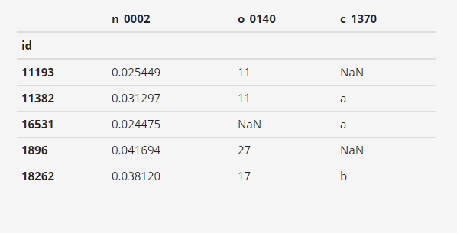
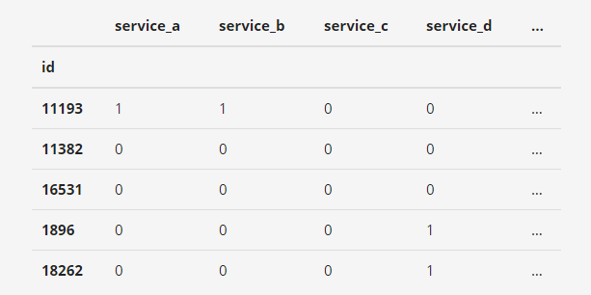
Data Descripton
Input Features
Target Variables

Slide 7
Final Deliverables
Deliverable 1 :
Your goal is to predict which health care services these respondents used in the last 12 months. Performance Metrics need to be published.
Note : Though the problem expects us to predict for 14 possible services you are free to pick up any 4 out of the 14
Deliverable 2 :
This solution needs to be seen in action. Models that are not operationalized are models, according to us, that are not built. The predictive model needs to be set up as a Rest API.

Slide 8
Task for the day
Don’t expect yourself to start building the final model today in the next one hour
Spend the next one hour understanding the data and devise an approach to solve this problem
Have a look at the target variables.
Think of the possible preprocessing steps
Is Feature Engineering possible with this data ?
What other information can we extract
Get Started !!!

